Slide 1



KOTO PRESENTATION
ASD ARCHITECTS

Slide 2
KOTO SYSTEM
ASD Architects
Middle East Investment Company
KOTO Engineering Affordability

Slide 3
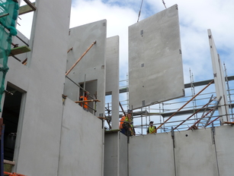
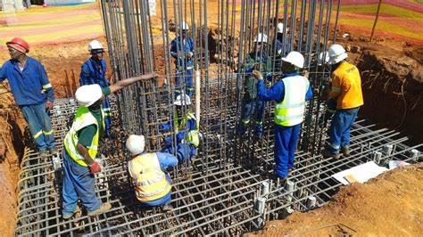
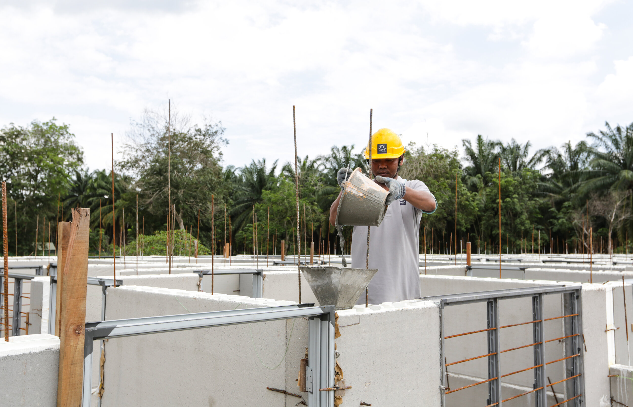
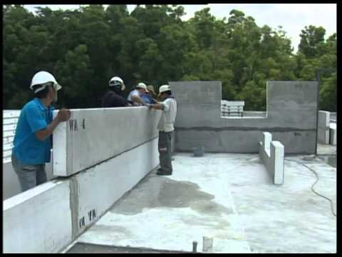
Construction System Comparisons
Precast Concrete
KOTO System
Construction time for 200m²: 6 to 8 weeks.
Construction time for 200m²: 2 to 3 weeks.
System: Precast Concrete Panels and slabs.
System: KOTO is an Insulated Permanent form building system.
Highly skilled Labors are required to handle precast during erection.
No skilled labor is required.
Limited panels can be transported.
V.S
300 m² of panels can be transported easily in one flatbed trailer.
Cranes are required for construction normally 80 T Capacity.
Cranes are not required for Panel Erection.
Limited design changes.
KOTO system is very flexible to design changes.
Require Joints sealant and Backing rods between Panels.
No Joints Sealant between Panels is required.

Slide 4
Other Features for KOTO System
Eco-friendly, Energy Efficient.
High fire resistance.
Pre-plastered base coat.
Less concrete and steel used.

Slide 5
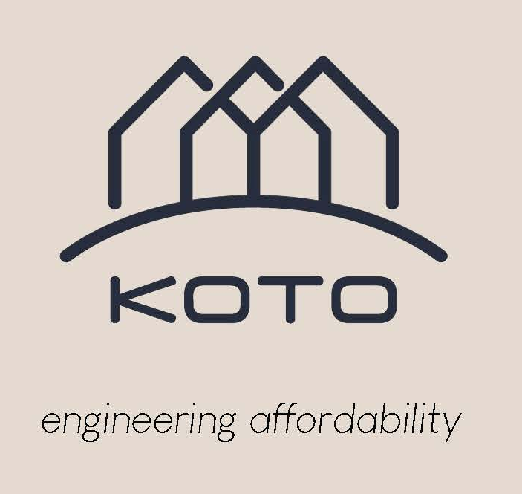
Overview
About us:
We are an affordable housing wall, roof and floor panel manufacturer.
KOTO started in 1974 in Australia.
We have presence in many countries around the world.
We pride ourselves in our product.
Mission & Value:
We are committed to decreasing carbon footprint.
An affordable home should really be affordable.
Protect environment with energy efficient housing material .

Slide 6
Overview
Technology
KOTO System Description:
KOTO is insulated permanent forms Building System consists of core holes and bond beams, ready for easy placement of reinforcing steel and concrete to connect the thickened ground edge-beam via the engineered multiple columns to the top bond-beam, herein providing a diaphragm shear wall system. All other core holes which are not required structurally left open are ideal for inserting computer cables, electrical, plumbing, and air-conditioner pipes.
Structural Engineering Description
KOTO ICF is made up of a series of vertical reinforced concrete cores connected to top and bottom horizontal reinforced beams. Depending on the application the system can alternatively act as “LOADBEARING
CONSTRUCTION”, “SHEAR WALL CONSTRUCTION” or “COLUMN AND BEAM
CONSTRUCTION” simply by varying the spacing of the vertical reinforced cores. For houses where there are minimal vertical or horizontal forces, the system is designed as if it is Column and Beam.
For high-rise construction, the system is designed as a combination of load-bearing walls (for building loads) and shear wall construction (for wind and earthquake loads).

Slide 7
Overview
The reinforced cores are designed as: -
1. Compression members for the vertical load.
2. Simply supported beams for horizontal face loads on the wall.
3. In combination with the horizontal beams, designed in a similar way to a Vierendeel truss for racking forces.
The KOTO building system, an internationally acclaimed building construction system, known for making high-quality, ultra-durable, energy-efficient, and affordable building systems was developed in 1974 in Australia and is currently popular worldwide.

Slide 8
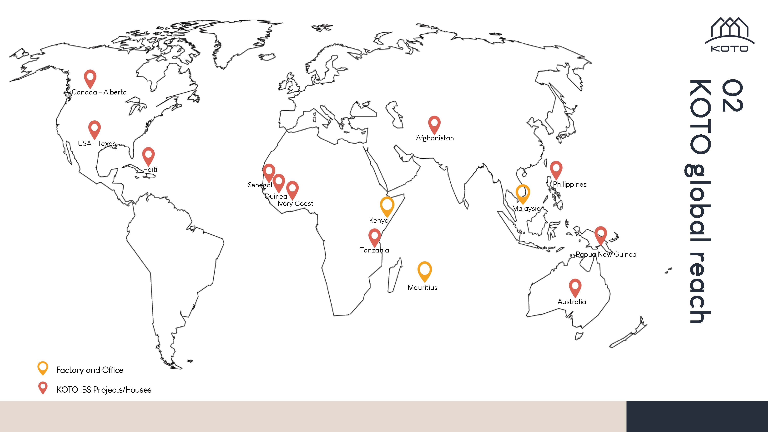
KOTO Global Reach

Slide 9
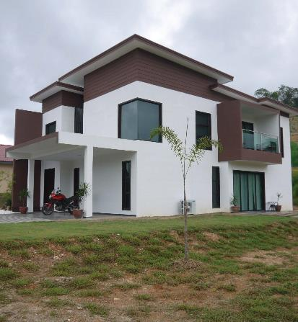
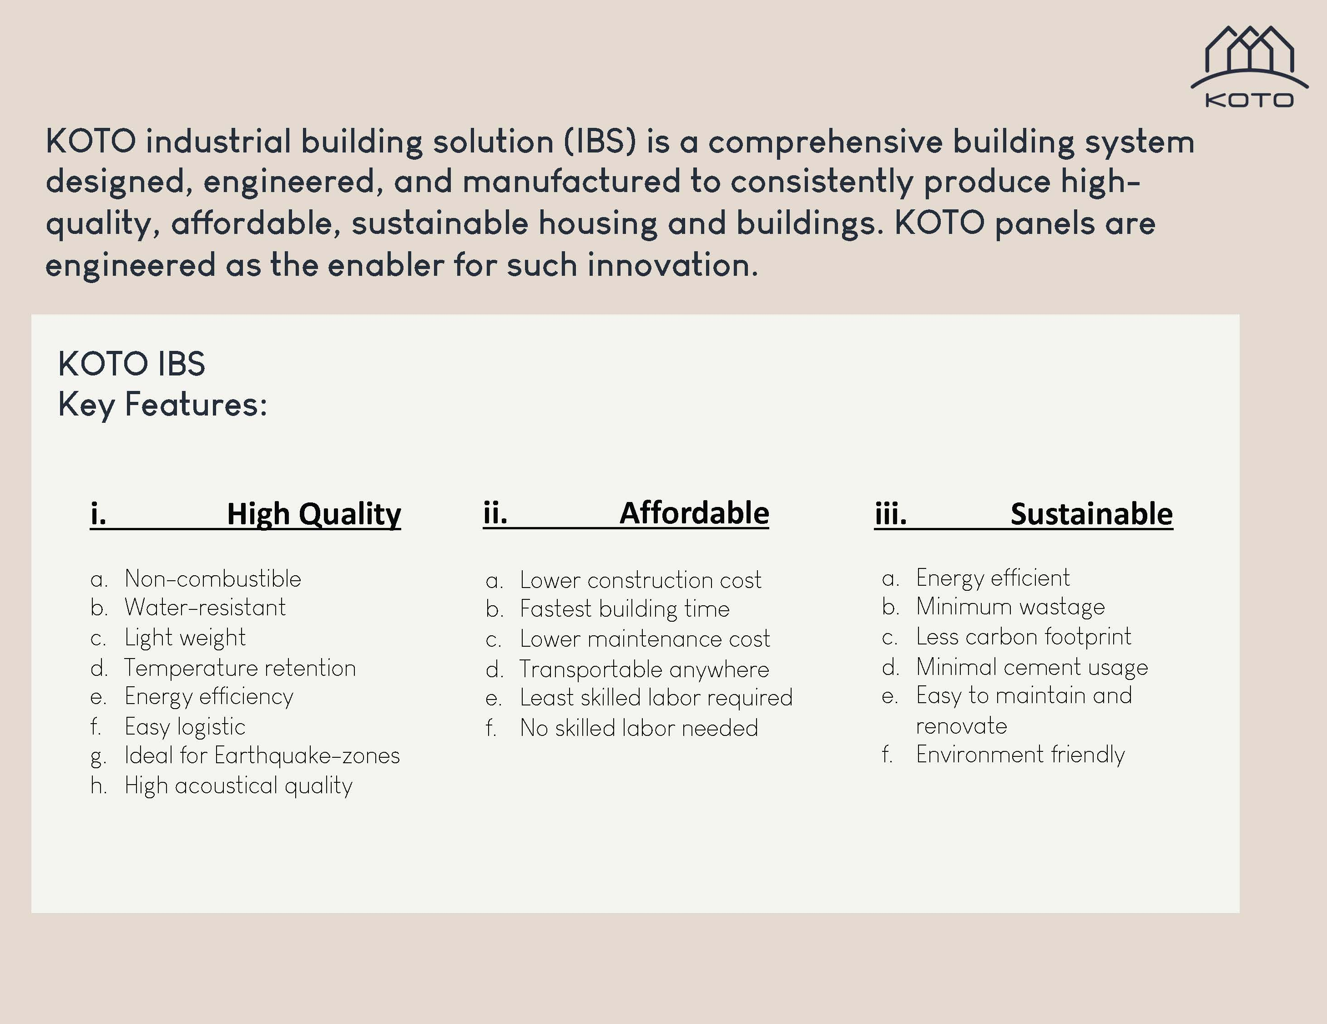
KOTO Industrial Building Solution(IBS)

Slide 10
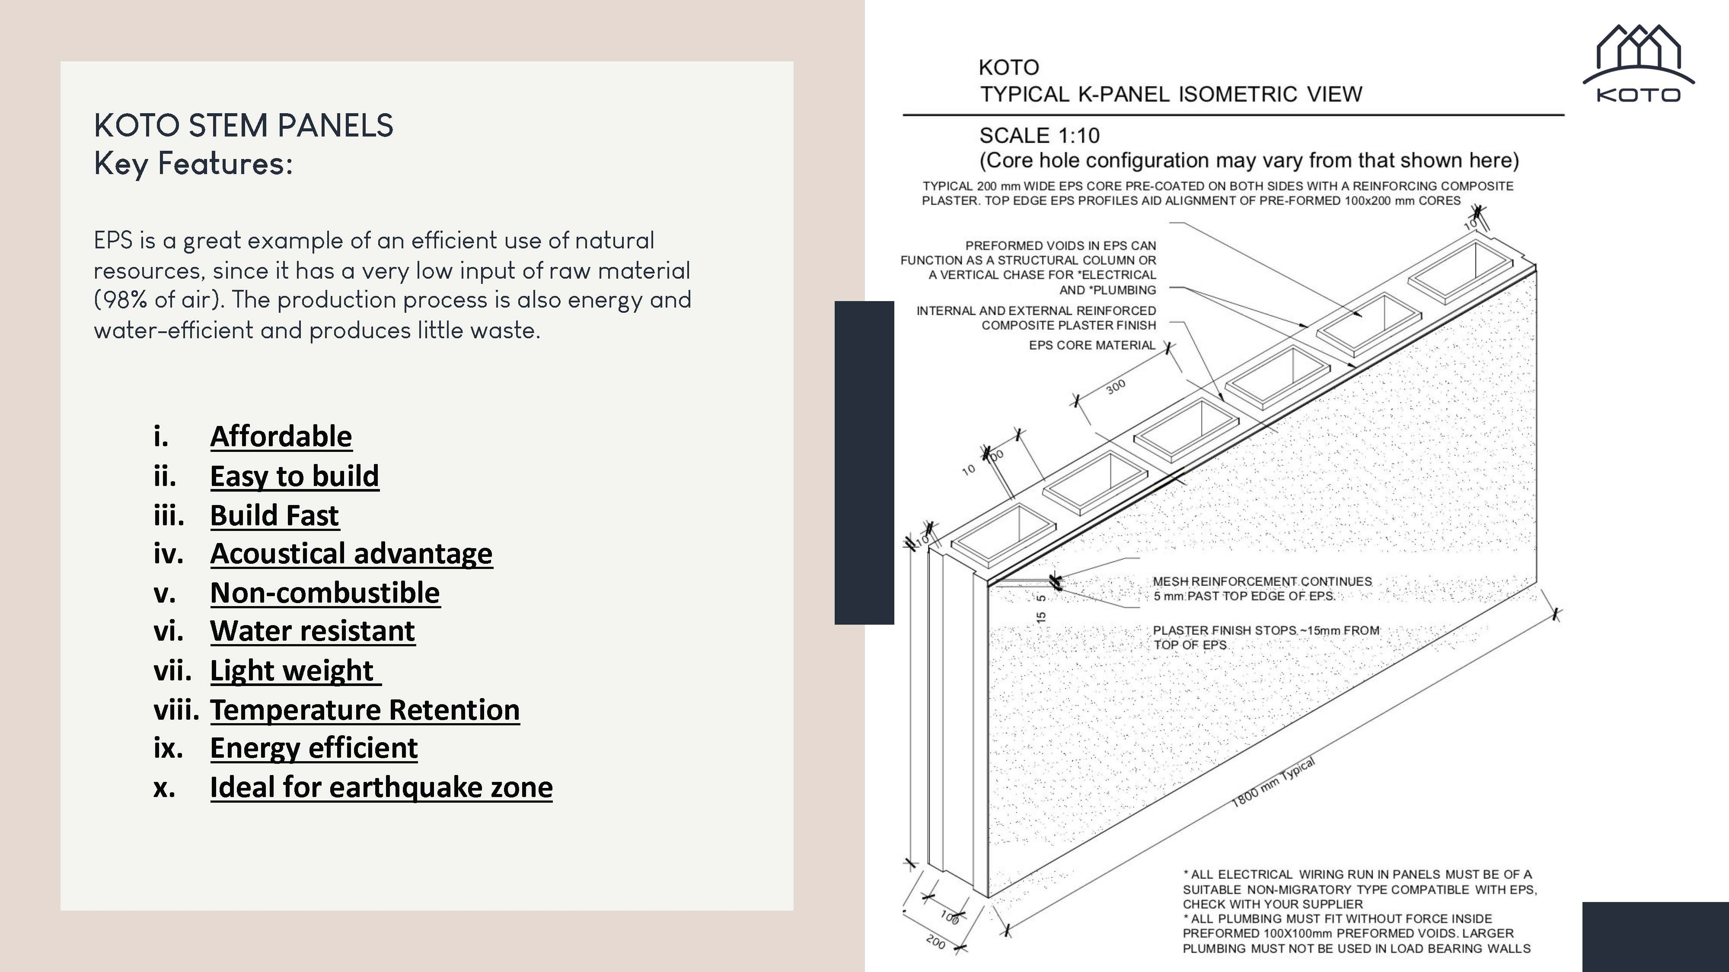
KOTO STEM Panels

Slide 11
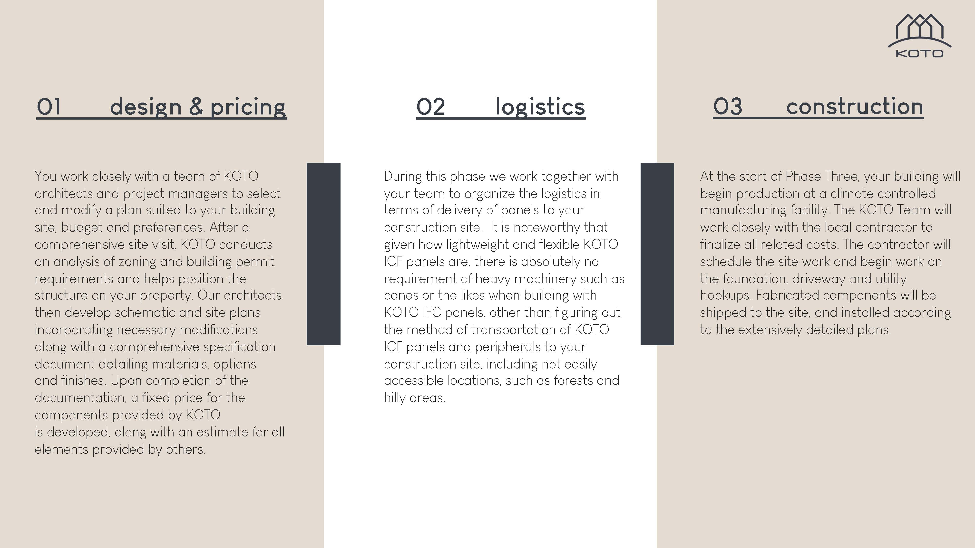
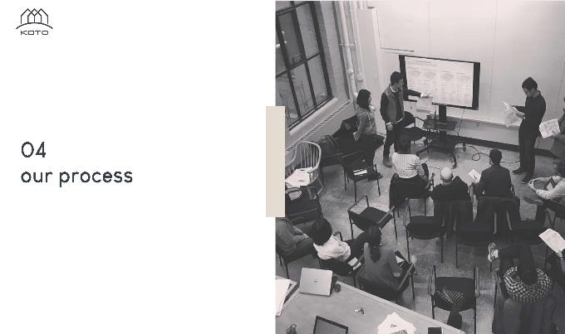
KOTO System Process

Slide 12
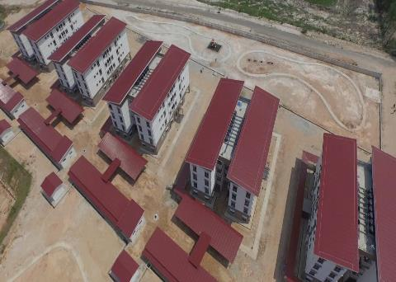
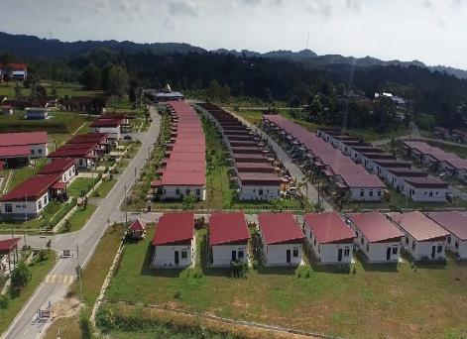
KOTO Projects
FELDA - Chini Timur - walk up apartments & landed single storey

Slide 13
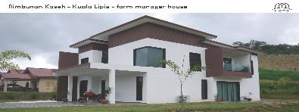
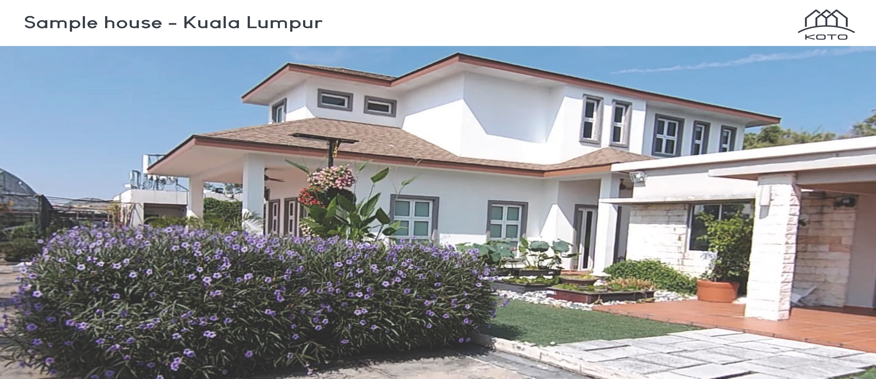
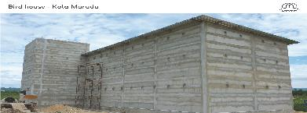
KOTO Projects
Rimbunan Kaseh - Kuala Lipis - farm manager house
Sample house - Kuala Lumpur
Bird house - Kota Marudu

Slide 14
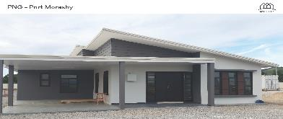
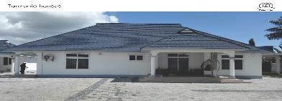
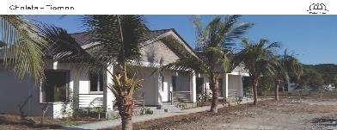
KOTO Projects
PNG - Port Moresby
Tanzania houses
Chalets - Tioman

Slide 15
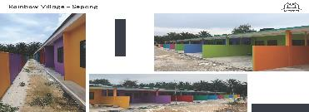
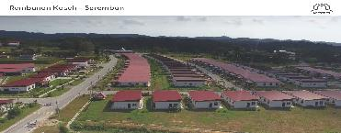
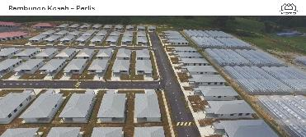
KOTO Projects
Rainbow Village - Sepang
Rembunan Kaseh - Seremban
Rembunan Kaseh - Perlis

Slide 16
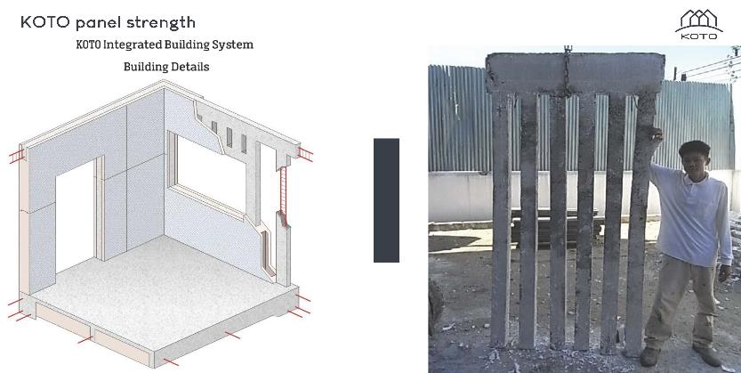
KOTO panel strength

Slide 17
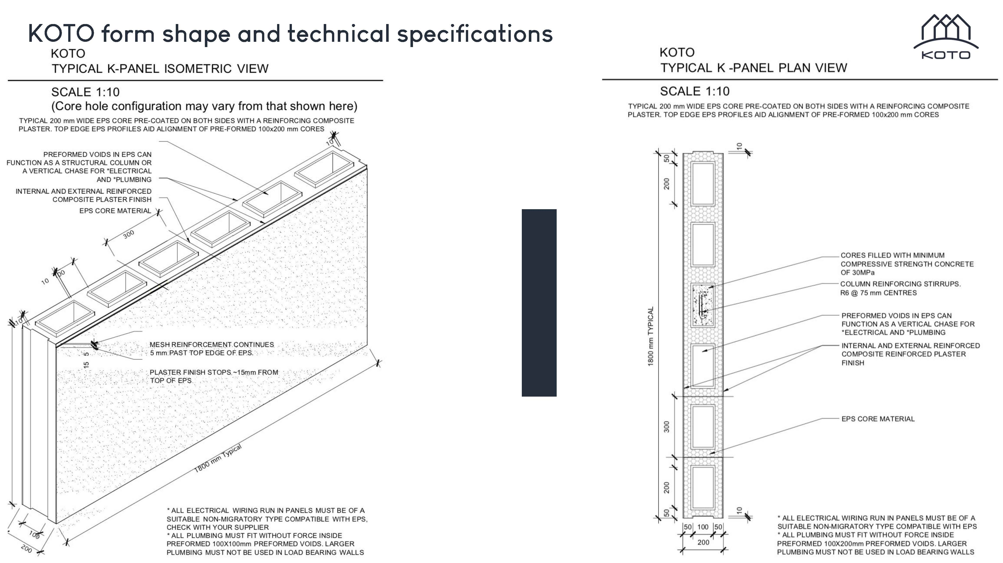
KOTO form shape and technical specifications

Slide 18
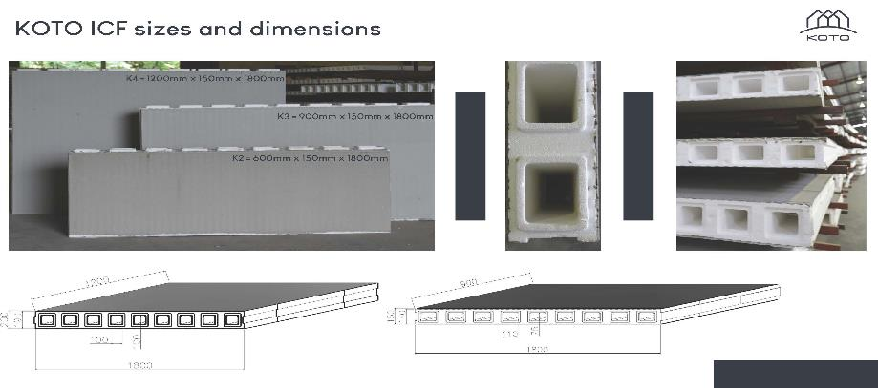
KOTO ICF sizes and dimensions

Slide 19
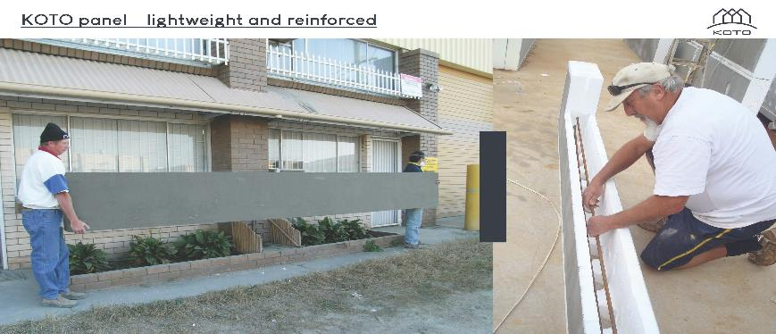
KOTO panel lightweight and reinforced

Slide 20
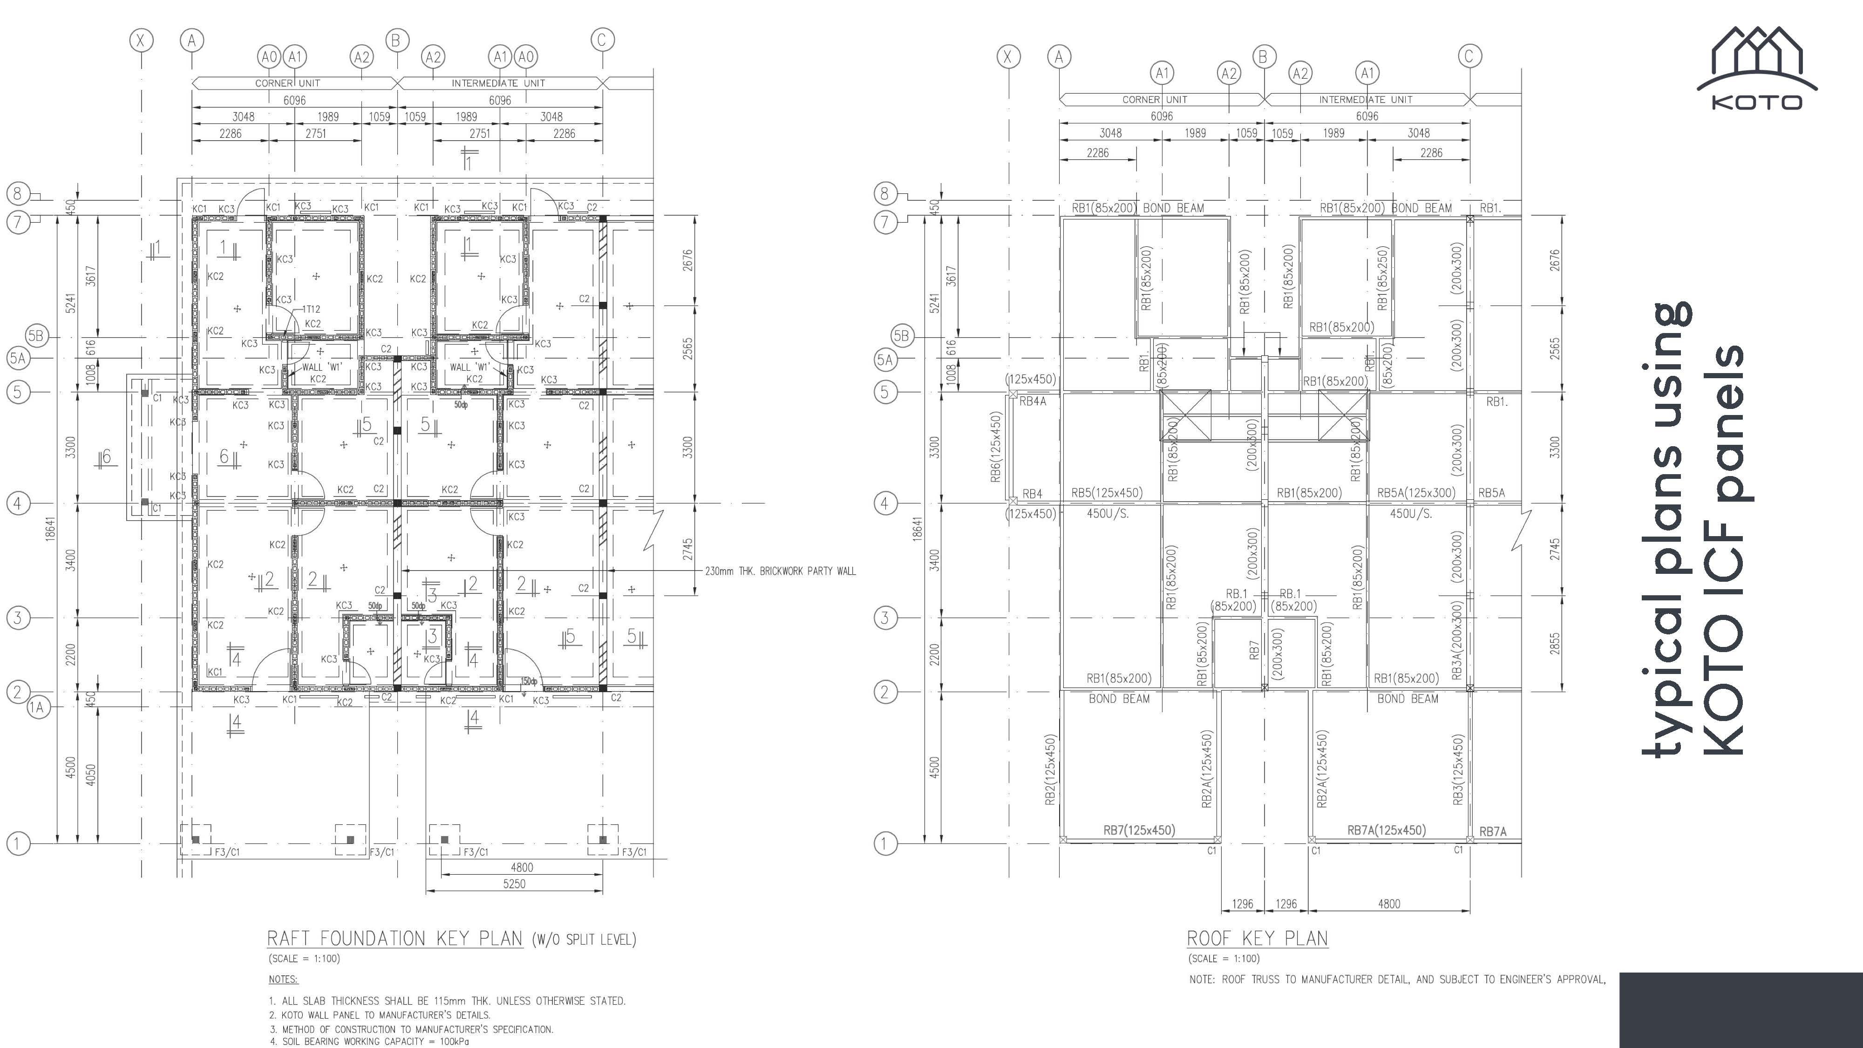
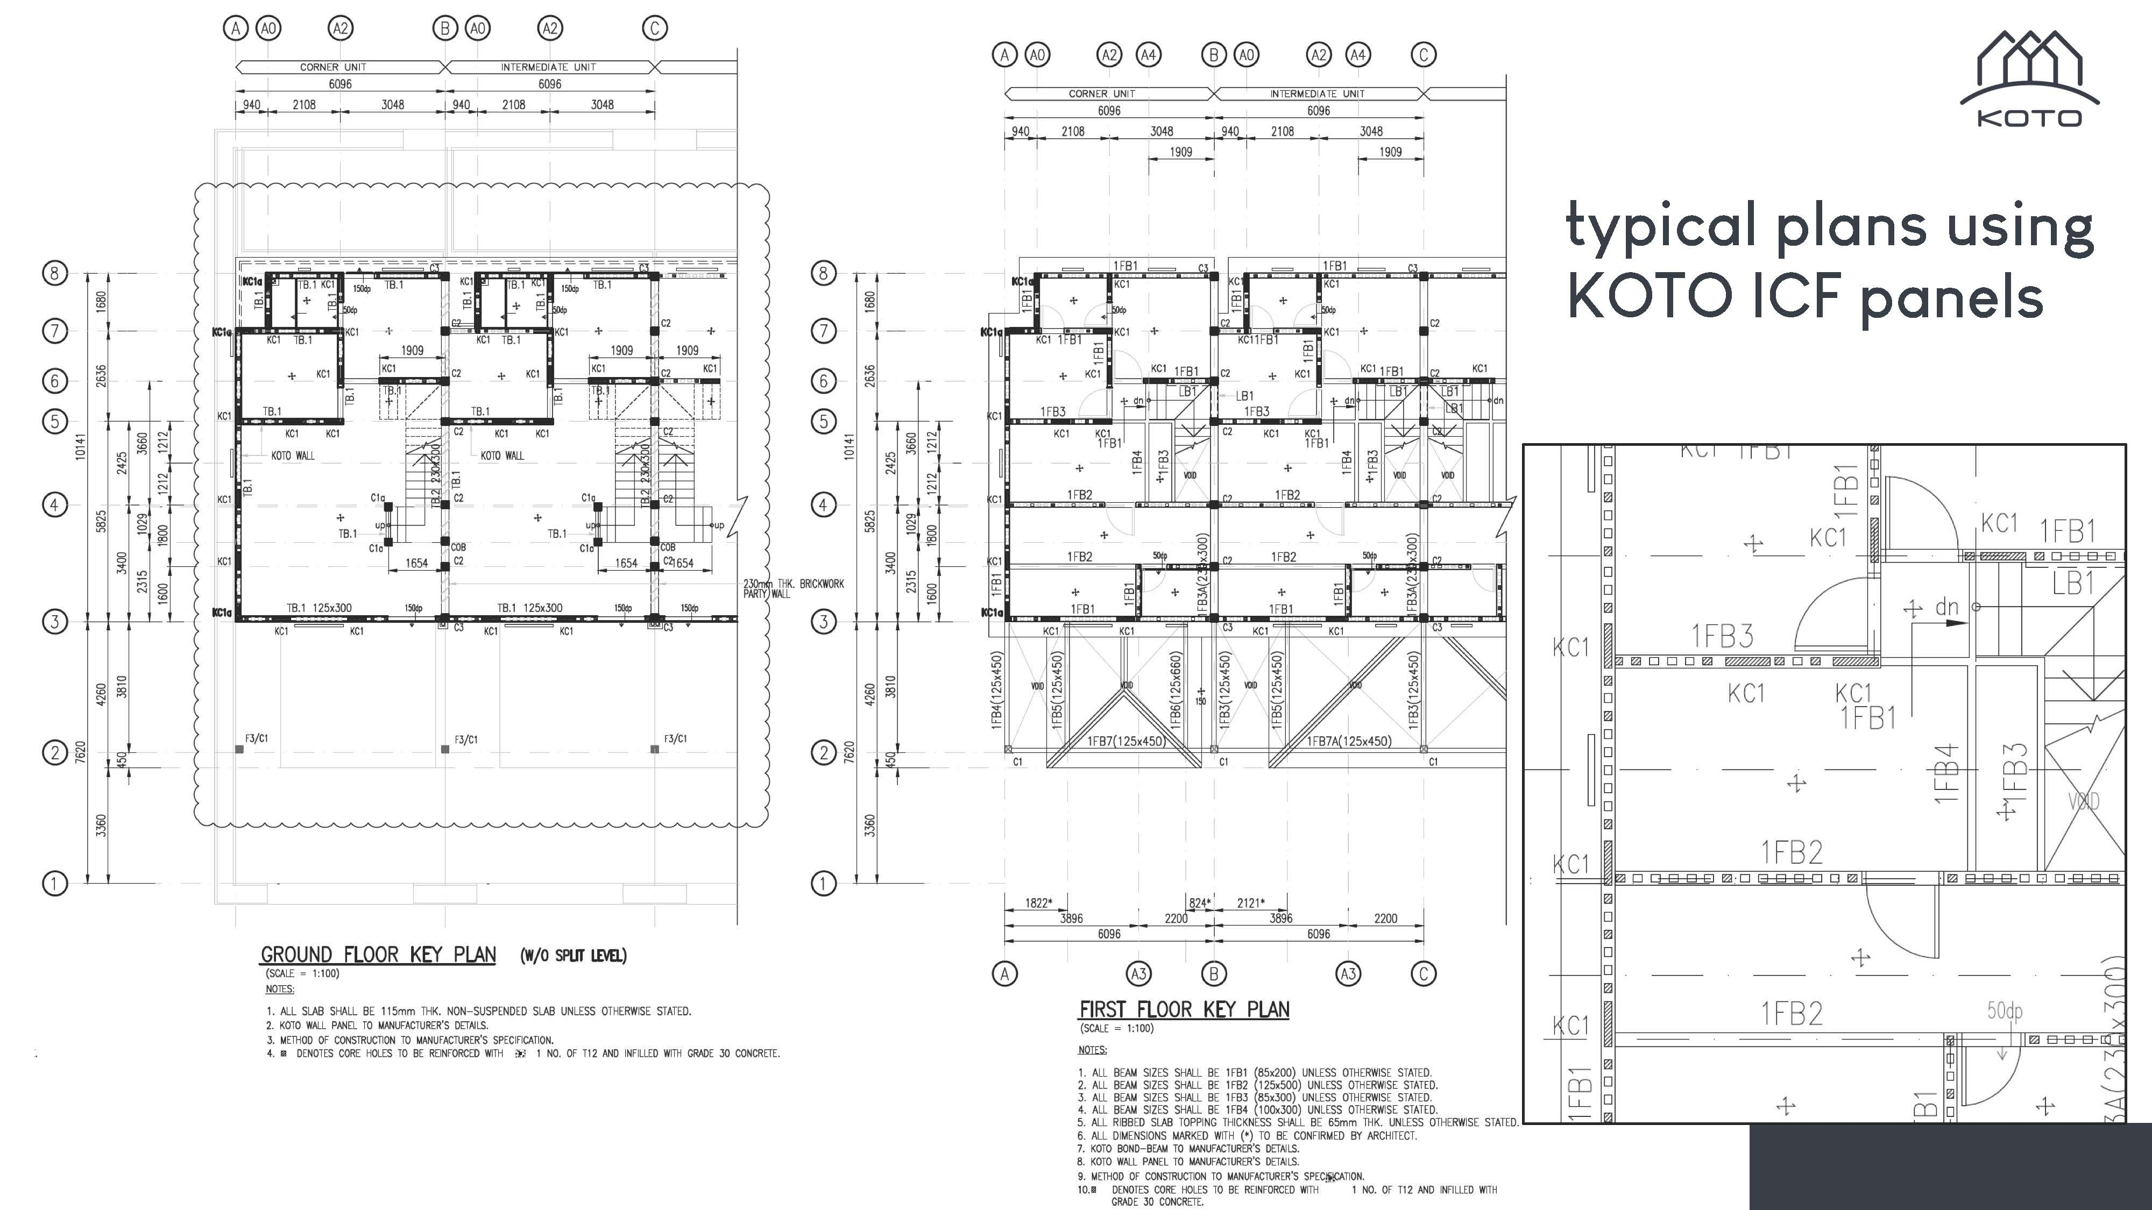
Typical plans using KOTO ICF panels

Slide 21
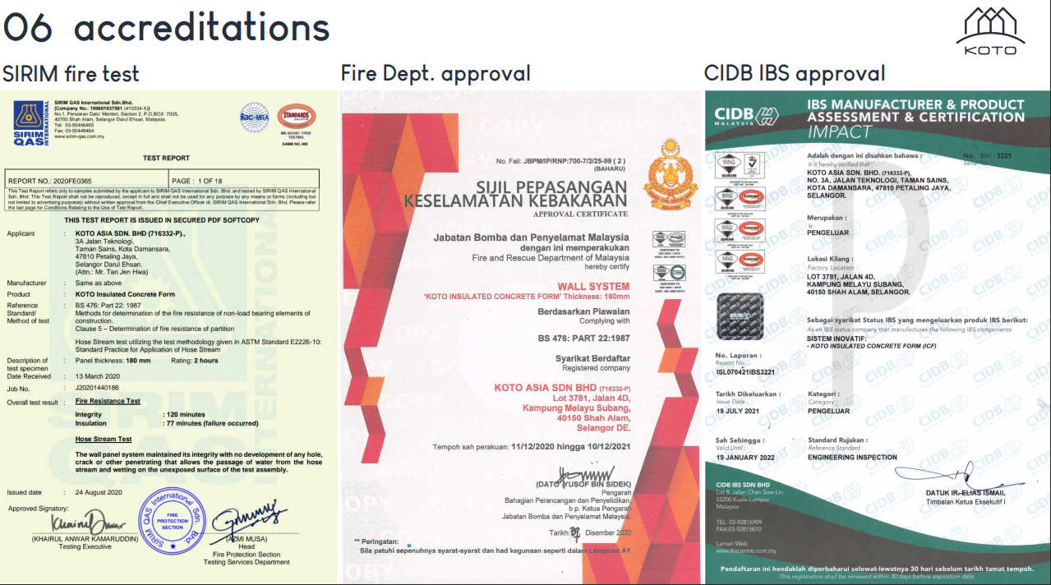
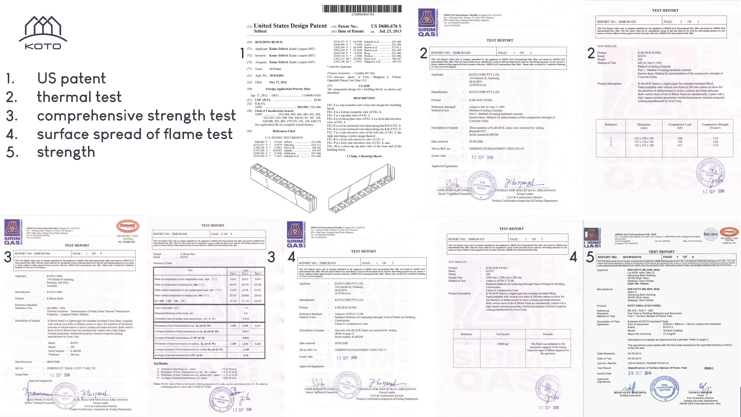
Accreditations

Slide 22








Potential clients
Saudi Aramco
Ministry of Housing
Ministry of Tourism
Royal Commisions for Jubail & Yanbu
Ministry of Defense
National Projects:
Private Developers:
Dar Al Arkan
Vivenda
Arfal
Al Majdiya
Al Argan
Al Jolan

Slide 23
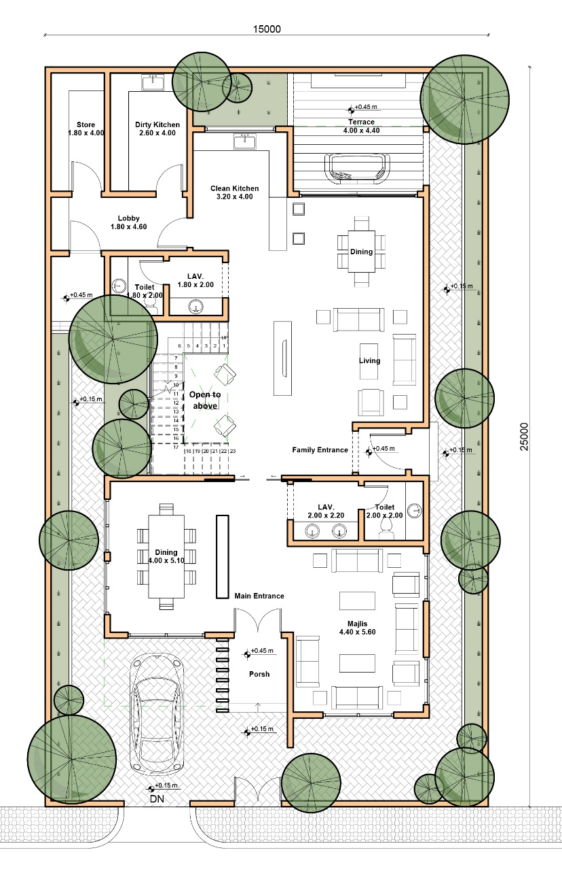
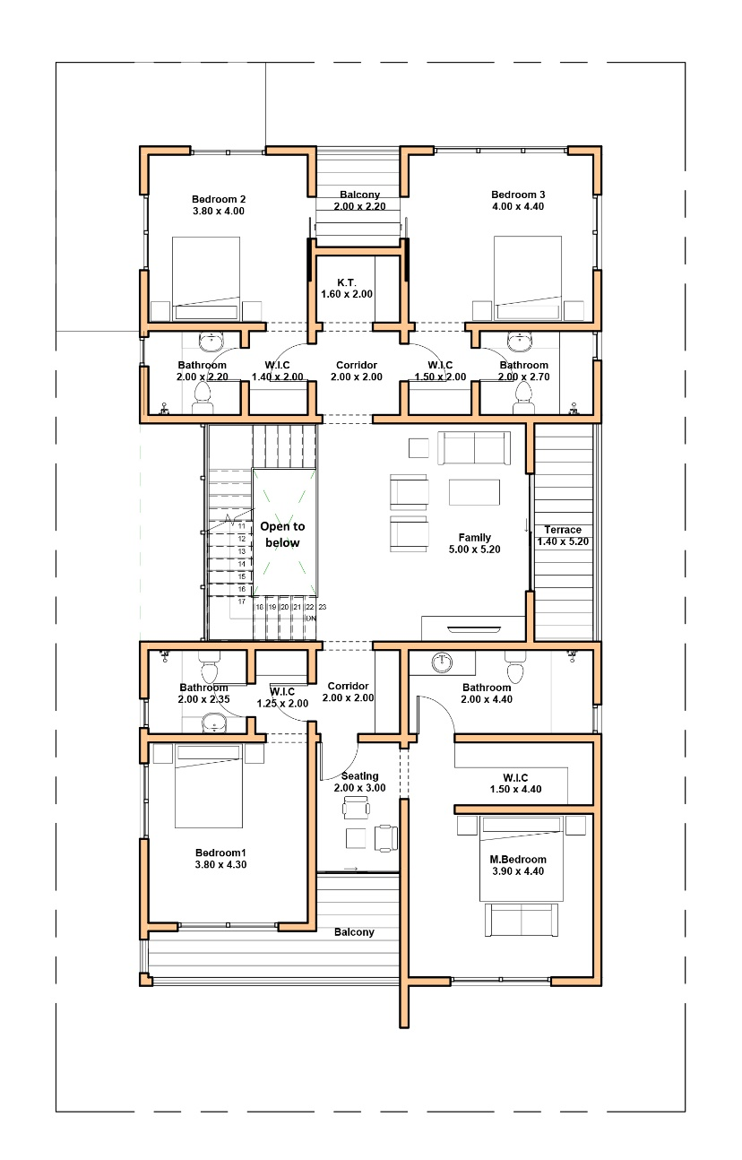
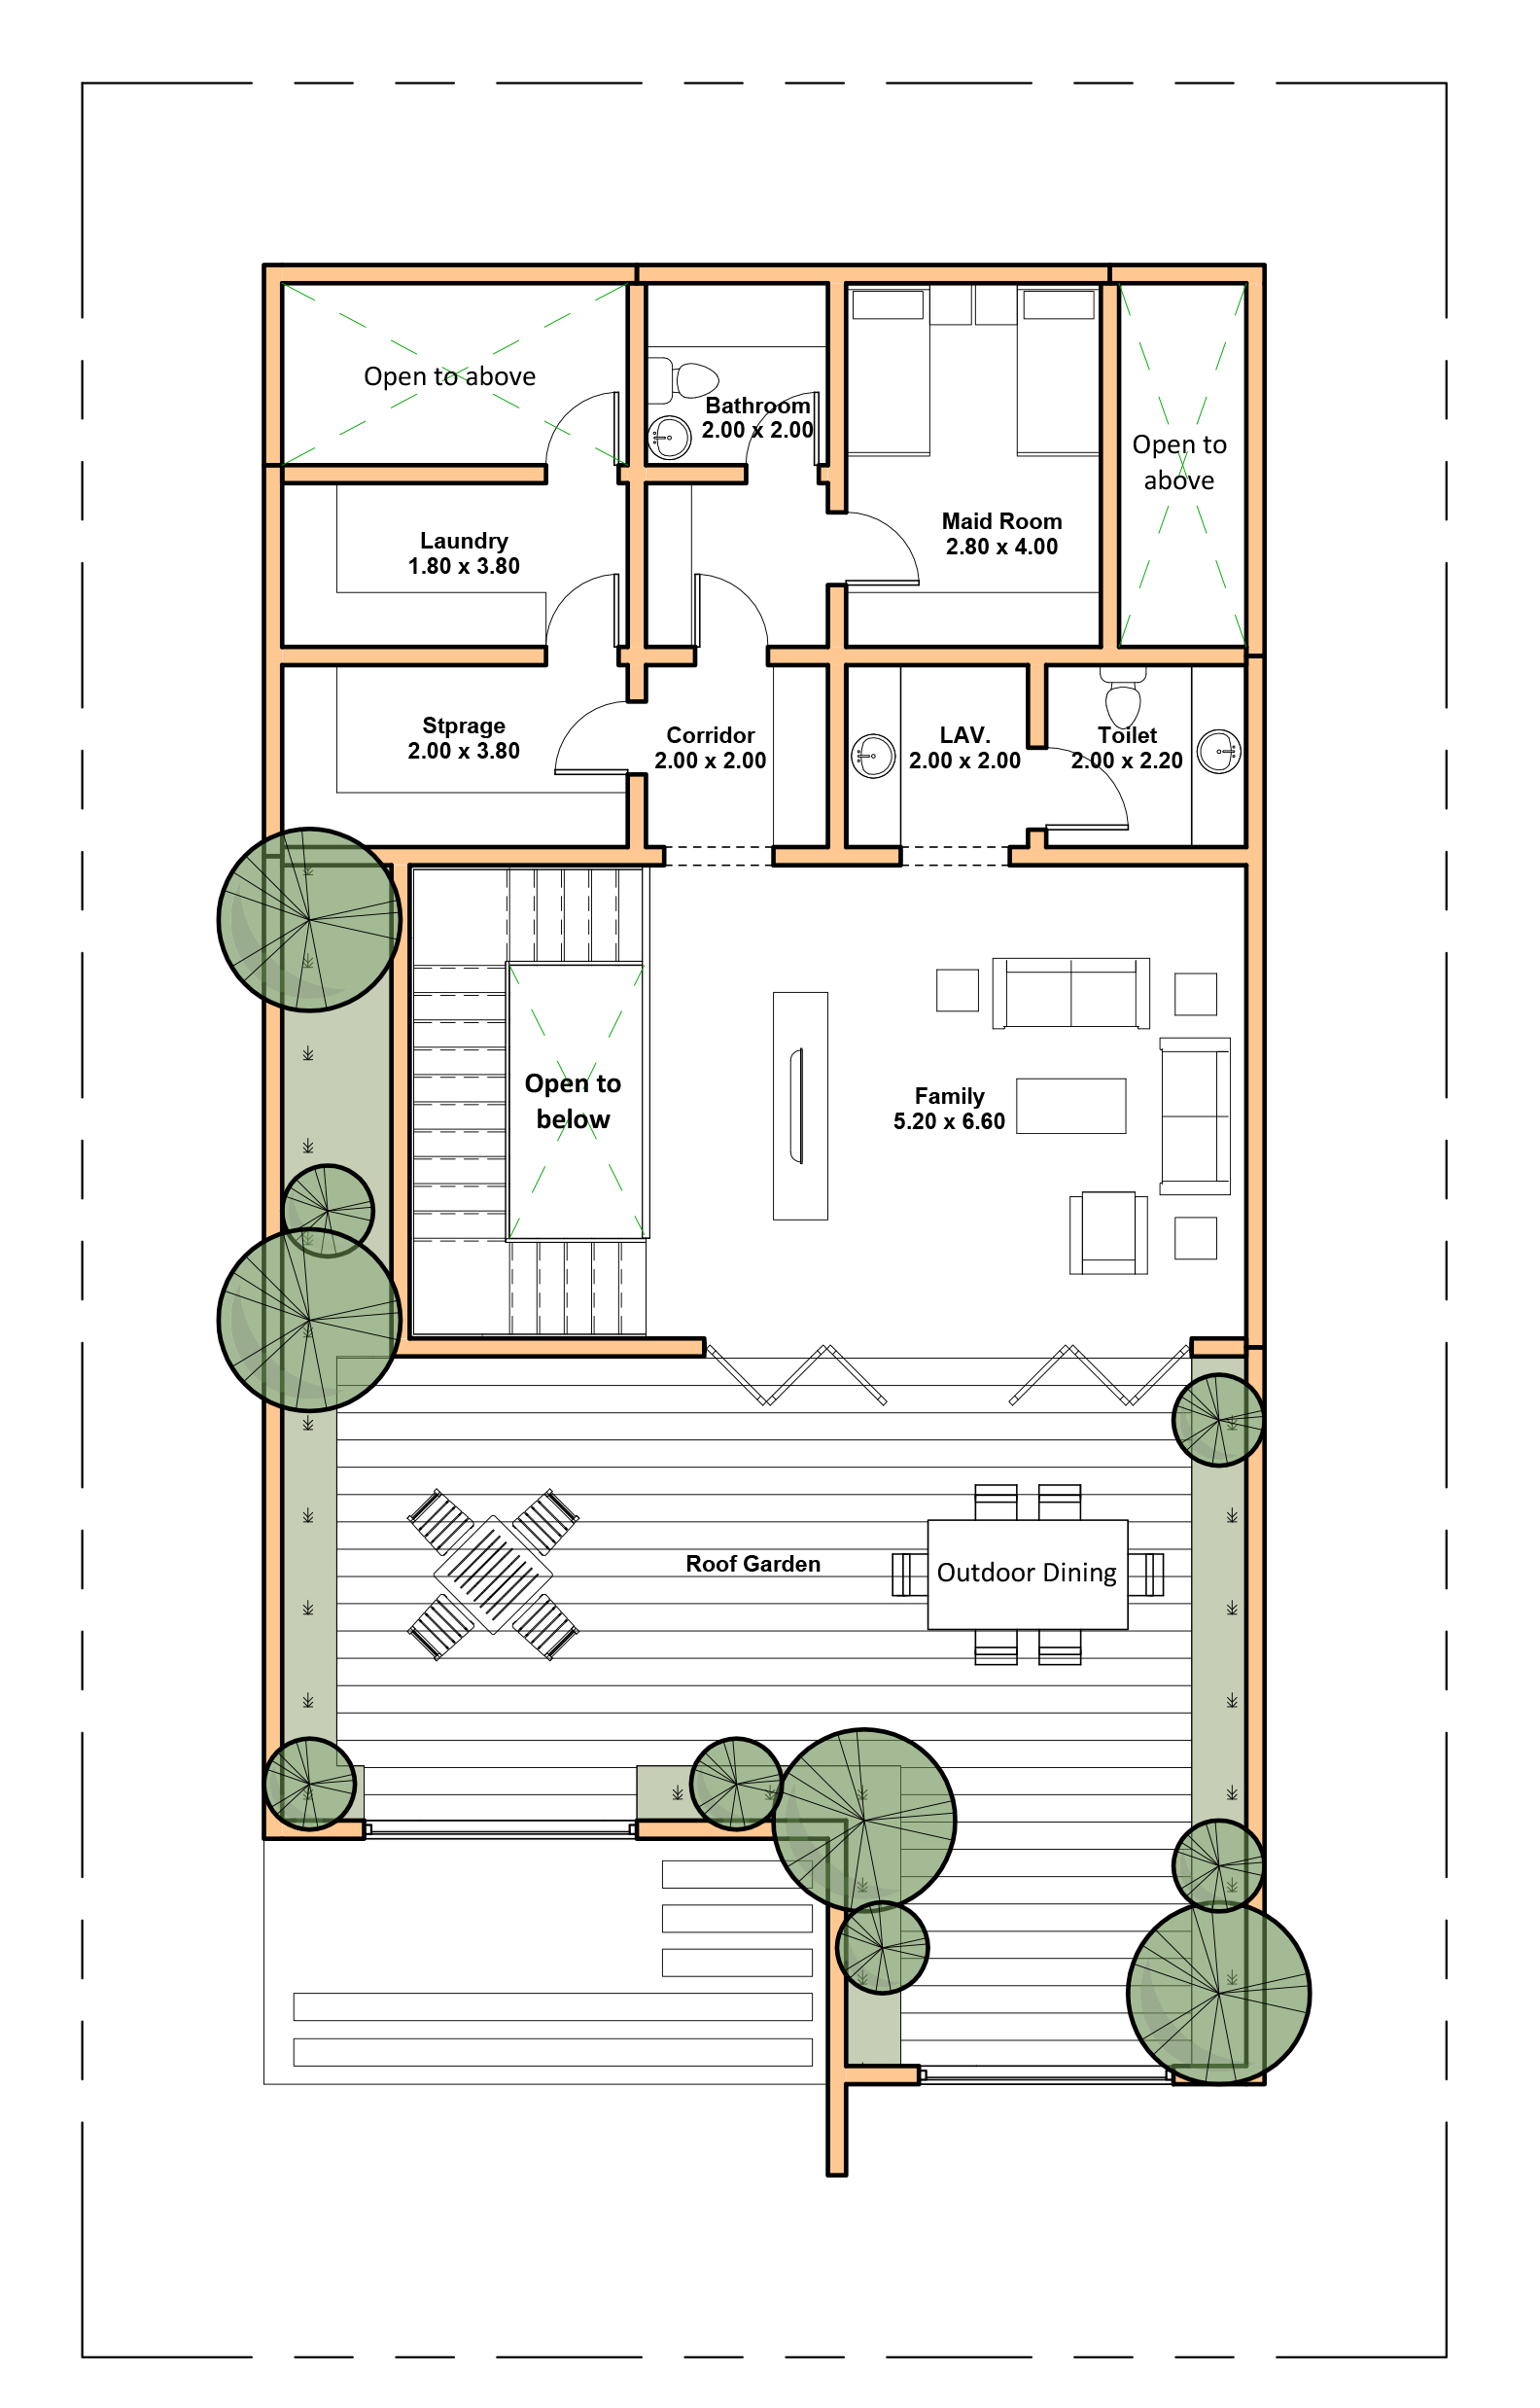
Design Option - plans
Ground floor
First floor
Second Floor

Slide 24
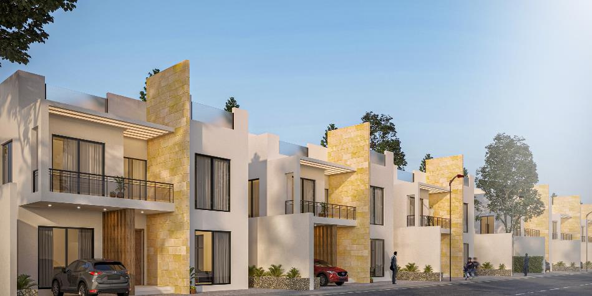
Design Option - Perspective

Slide 25
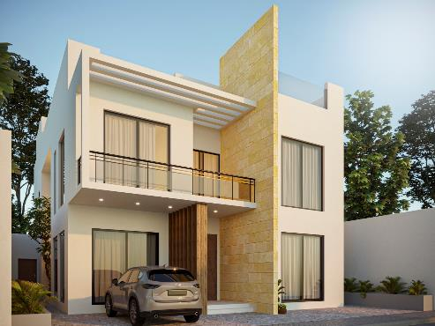
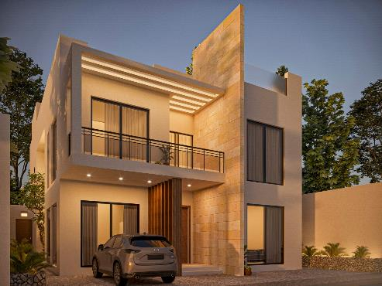
Design Option - Perspective

Slide 26
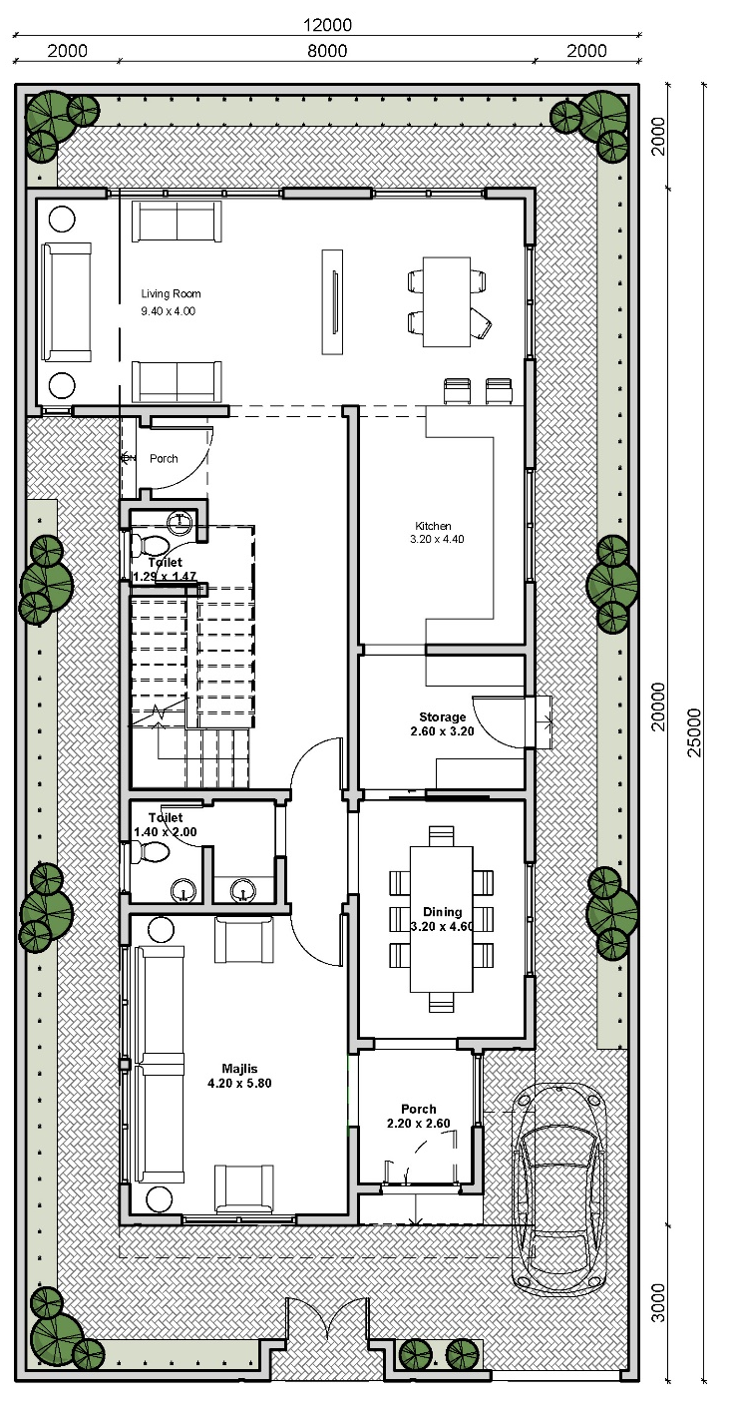
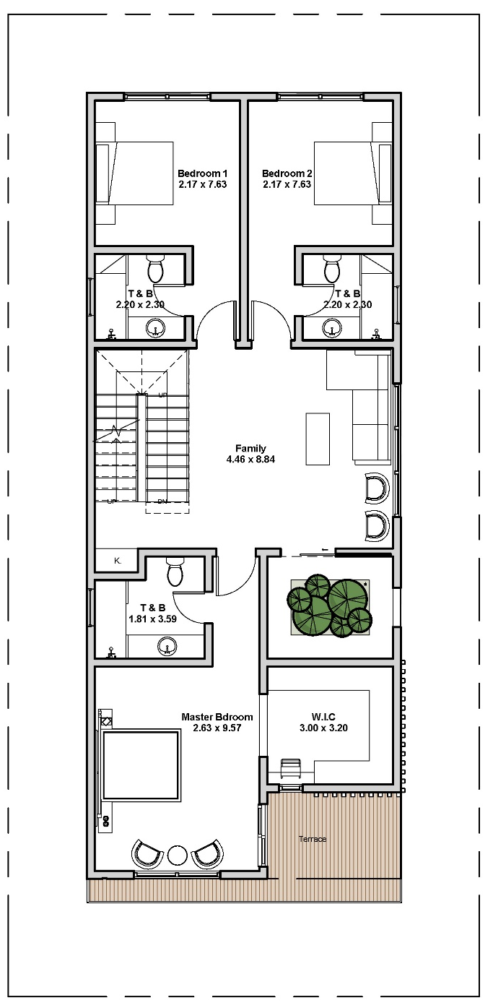
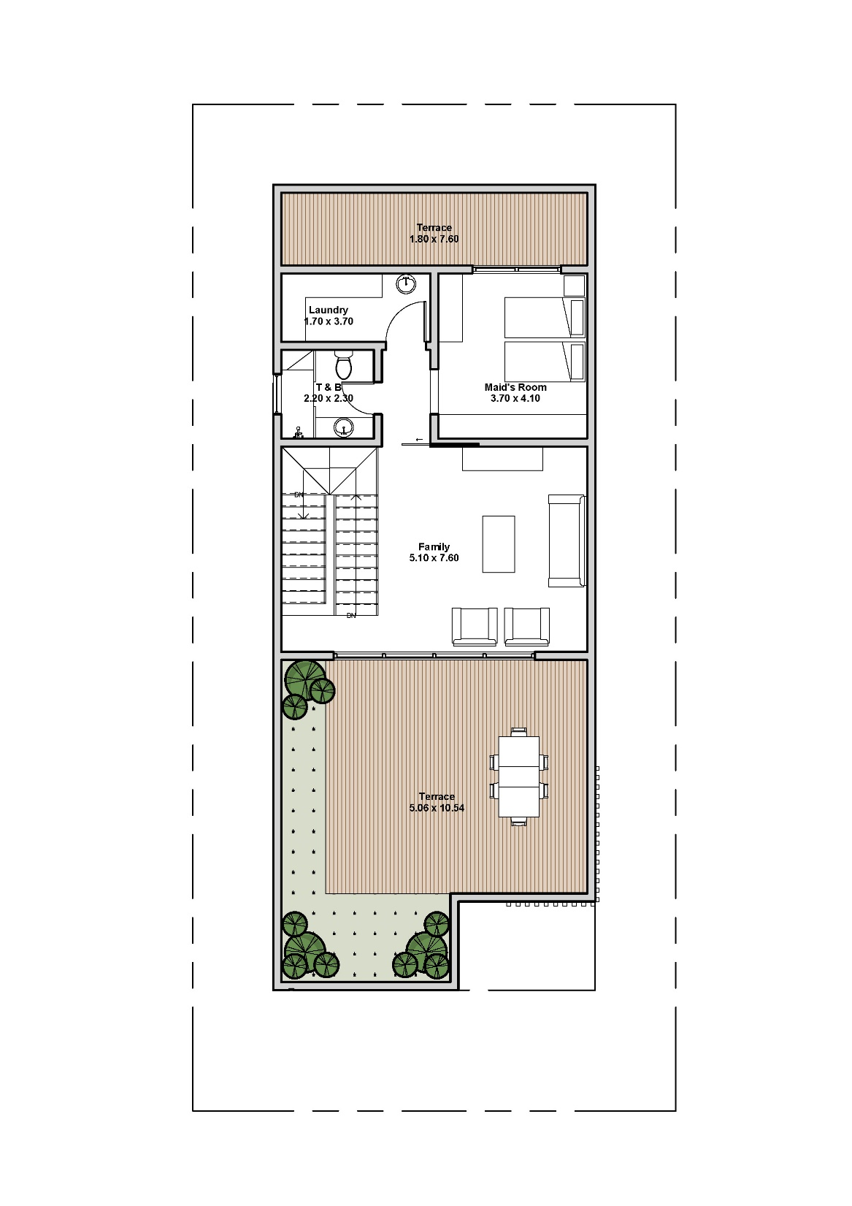
Design Option - plans
Second Floor
Ground floor
First floor

Slide 27
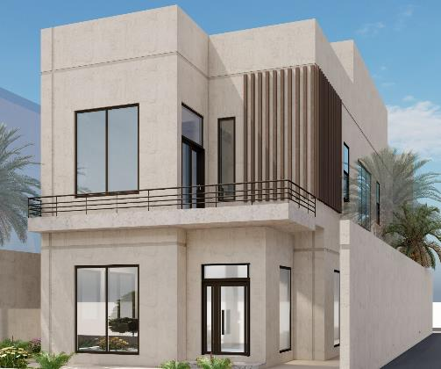
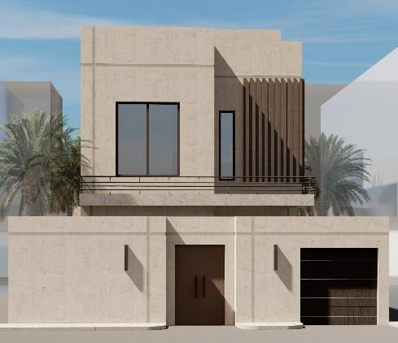
Design Option - Perspective

Slide 28
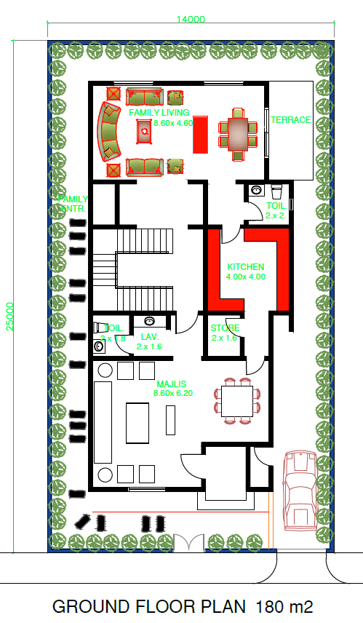
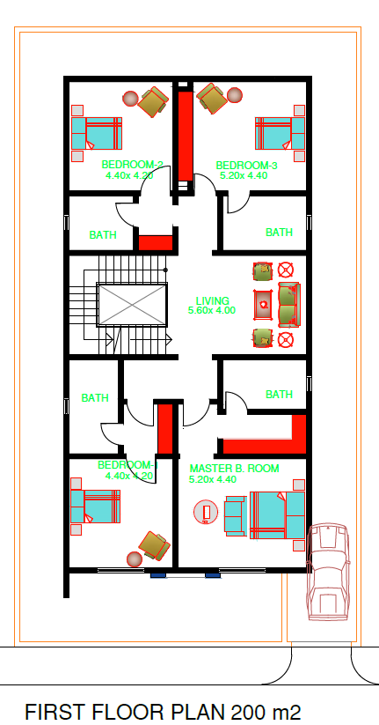
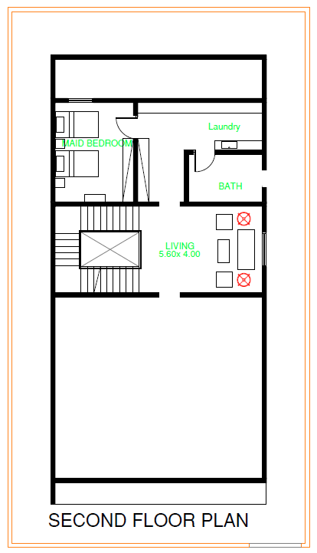
Design Option - plans

